Slide 1
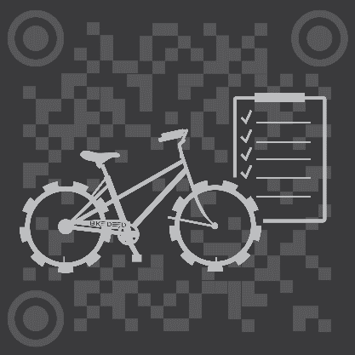
BikeDeed
Blockchain Protected.

Slide 2
BlockCHAIN Revolution?
Getting the average person to see beyond the hype of tokens, Blockchain and ICOs is a difficult task. People need to be exposed to real-world applications that are based on concepts they already understand before they will be open to the ideas that make Decentralization so exciting and revolutionary. That was the primary motivation for creating BikeDeed.
The gigantic market of bicycle ownership represents a unique opportunity to bring a significant portion of the world’s population into the Blockchain ecosystem, leading to further opportunities of exposing them to a myriad of other products.

Slide 3
The Problem
There is currently no Universal, Trusted, Borderless, Decentralized repository for the registration, transfer and tracking of bicycles.
“So, why should I care?”

Slide 4
The Numbers
Two Billion 2,000,000,000
Number of bicycles in use around the world.
One Hundred Million 100,000,000
The number of new bicycles manufactured, shipped and sold worldwide each year.
One and a Half Million 1,500,000
Number of bicycles stolen each year in the U.S.
Eleven 11
The number of bicycles currently registered on the Blockchain.

Slide 5
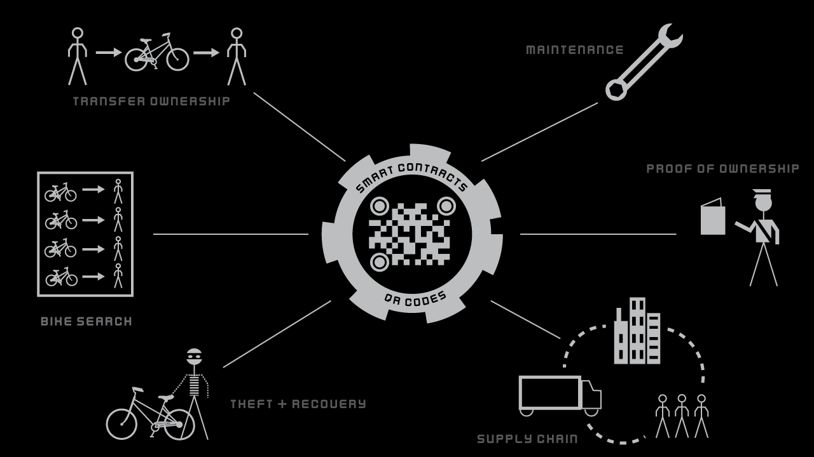

Slide 6
How it works
A Universal, Trusted, Borderless, Decentralized, repository for the registration, transfer and tracking of bicycles.
Each bicycle is labeled with a QR Code and registered on the Blockchain before it leaves the factory. When the bicycle is shipped to the wholesaler, the BikeDeed dApp is used to transfer ownership of the the ERC 721 deed to the wholesaler’s wallet. The same process occurs when the bike is shipped to the Local Bike Shop for retail sale. When the bike is finally sold to an individual - or between individuals – ownership of the bicycle’s deed is transferred to from one individual’s wallet to the other. At every stage of the bicycle’s voyage, the QR code on the bicycle is used to record the time and location of each Supply Chain Event making it a public record on the Blockchain. Every time maintenance is performed on the bike, the QR code and BikeDeed dApp is used to record the time, location, cost and description of the work. That information remains a public record on the Blockchain. This rich Blockchain history deters theft and facilitates successful reunion after a bike is recovered – especially in the case of international trafficking.

Slide 7
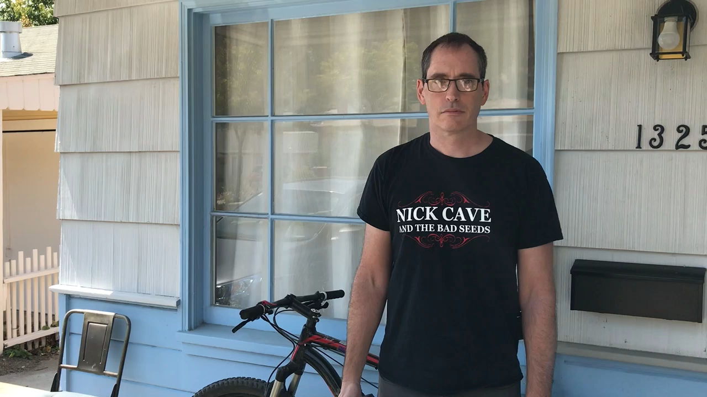
The 30 Second Demo

Slide 8
The Competition
BikeDeed Does Not See Competitors, only Partners.
Currently, most bicycle registration solutions have a narrow and altruistic goal. To prevent theft and reunite stolen bicycles with their owners. BikeDeed sees itself partnering or joining with these other organizations to continually improve that process.
Who else do we see ourselves partnering with? Manufacturers, Shipping Companies, Local Bike Shops, Law Enforcement Organizations, Athletic Organizations and Bicycle Cooperatives, in addition to Developers who which to extend the BikeDeed ecosystem into new directions.

Slide 9
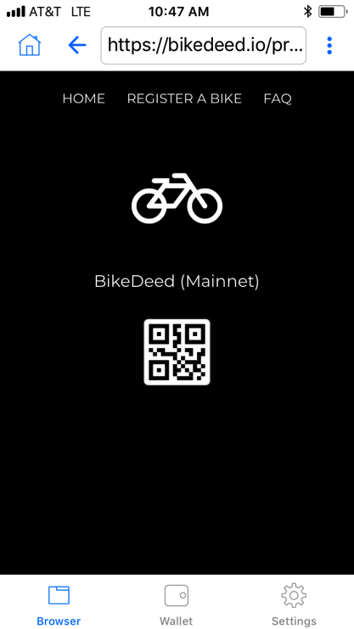
Features
Transfer of Ownership.
Maintenance Tracking.
Proof of Ownership.
Supply Chain Tracking.
Theft and Recovery.
Search Bikes and Owners.
Data Discovery.

Slide 10
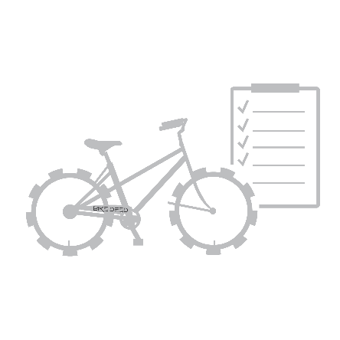
The Geek Stuff
BikeDeed is a Decentralized proof-of-ownership application running as a smart contract on the Ethereum Blockchain. Technologies include:
ERC721 non-fungible tokens
IPFS
Web3
The Minimum Viable Product is up and running on the Ethereum mainnet now. Go to https://bikedeed.io/app

